Slide 1
EU Funding: Brexit myths vs. reality
Belen Rebollo-Garcia
Belen.rebollo@york.ac.uk
EU Research & Development Team
Research & Enterprise
22 February 2018 – YRAF Forum

Slide 2
Brexit-related concerns
Does Brexit mean no EU funding?
What is the UK status during the transition?
Are we still eligible for ERC?
Is there an evaluation bias in H2020?
Do EU partners still want to include us?
Is the Government underwriting EU grants?
Can I bring a Marie Curie Fellow?
Notes:
-Ideally we would like an Associated Country status for all funding programmes, which would entail minimum visa restrictions for incoming researchers (from EU and beyond).

Slide 3
Does Brexit mean no EU funding?
Brexit does not mean no EU funding!
UK is full member of the European Union with all rights and obligations right until the end of the 2-year period (March 2019) following the trigger of Article 50
Joint Report (UK-EU; 08/12/2017): the UK will continue to pay net contributions until the end of the current EU budget plan in 2020. The UK will continue to benefit from EU programmes during the period 2019-2020 post exit, including from Horizon 2020
Notes:
-Ideally we would like an Associated Country status for all funding programmes, which would entail minimum visa restrictions for incoming researchers (from EU and beyond).

Slide 4
UK Gov Underwrite Guarantee
The UK Government Underwrite Guarantee remains valid. Irrespective of the Joint report Statement and final agreement:
The Guarantee covers proposals submitted before exit on March 2019
even if not yet awarded
even if only submitted at first stage
HM Treasury statement (2016) encouraging UK organisations to continue applying
Notes:
-Ideally we would like an Associated Country status for all funding programmes, which would entail minimum visa restrictions for incoming researchers (from EU and beyond).

Slide 5
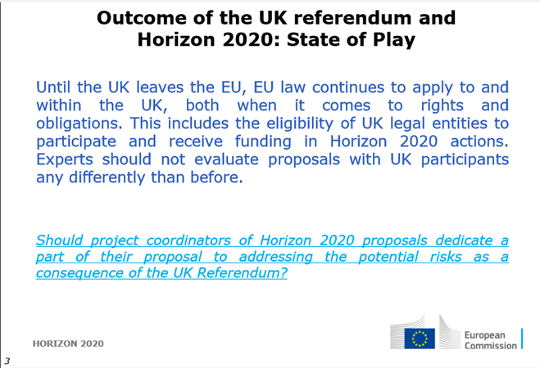
Evaluation bias in Horizon 2020?
Evaluators have been briefed not to judge proposals with UK participants any different than before June 2016:
Some evaluators are British!
Notes:
Some of the evaluators are British!
Briefed not to discriminate – with UK Gov underwriting grants, there is no excuse to mark down a project because of Brexit, i.e. fearing a UK based partner might withdraw due to lack of funding no longer there.

Slide 6
Brexit resources and statements?
UoY Statement: Post-Brexit statement about our participation in H2020
UK-EU Joint Report
The UK Government Underwrite Guarantee
BEIS: research@beis.gov.uk special inbox to report issues available for UK and non UK participants
EC website on the Taskforce on Article 50
RCUK statement welcoming the UK Government’s commitment on Horizon 2020
UUK has a dedicated section on “Brexit and UK universities”
UKRO Brexit FAQs
EC Team @York Google+ updates
Google Community: UoY EU Research
https://plus.google.com/u/0/communities/105948861388317250688
Notes:
-Ideally we would like an Associated Country status for all funding programmes, which would entail minimum visa restrictions for incoming researchers (from EU and beyond).

Slide 7
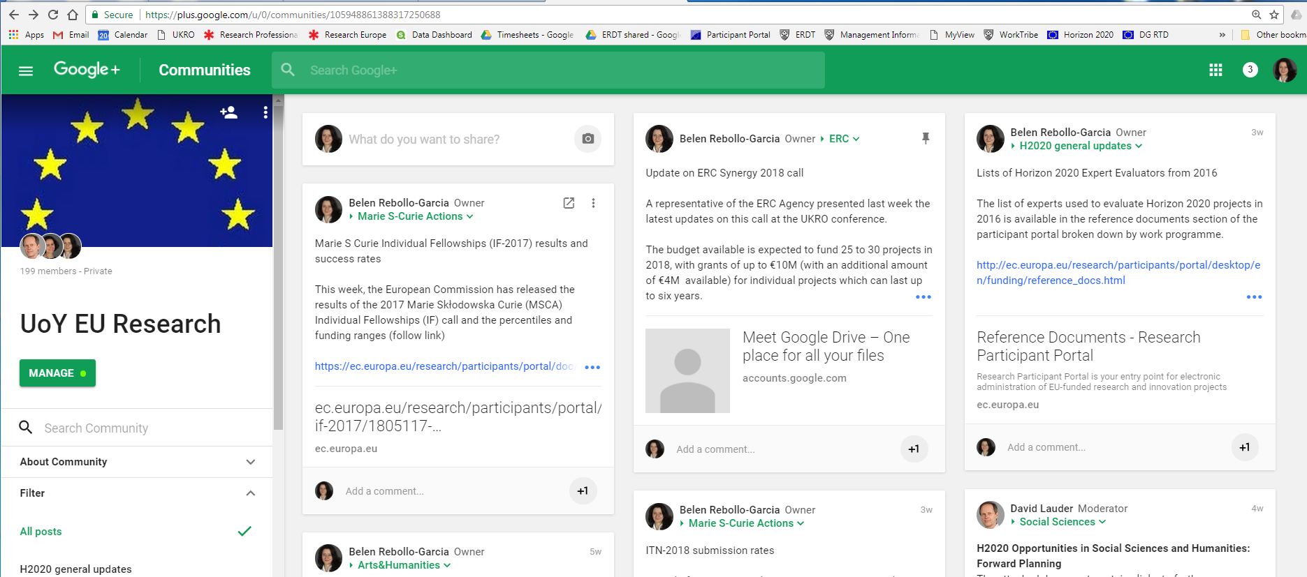
Brexit updates from EC Team @York
Notes:
-Ideally we would like an Associated Country status for all funding programmes, which would entail minimum visa restrictions for incoming researchers (from EU and beyond).

Slide 8
UoY EC latest success stories & messages
21.8% success rate in IF 2017 (awarded Jan 2018)
UK success rate 15.3% and EC average success rate 13.4%
Call in Sept 2018 has increased budget from 248M€ to 273M€
Record submission level to ITN 2018 call with 37 proposals (8 as coordinator)
Evidence of inclusion in consortia
Call in Jan 2019 has increased budget from 442M€ to 470M€
Under current agreement to participate until end of H2020 we are still eligible for (number of calls)
ERC-St (2), ERC-Co (2), ERC-Ad (3), ITN (2), IF (3)
H2020 WP (2018-2020) budget €30 billion. Priorities:
- A low-carbon, climate resilient future: €3.3 billion; - Circular Economy: €1 billion; - Digitising and transforming European industry and services: €1.7 billion; - Security Union: €1 billion; - Migration: €200 million.
Notes:
-Ideally we would like an Associated Country status for all funding programmes, which would entail minimum visa restrictions for incoming researchers (from EU and beyond).

Slide 9
Thank you- Questions?

